Slide 1
Alamouti Code and Schemes
By Mohamed Ibrahim, Felix Liu, and Shuihan Liu

Slide 2
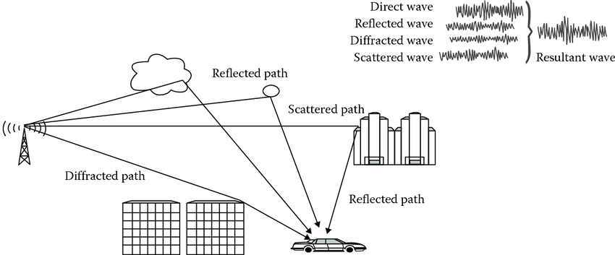
Continuous Challenge of Wireless Communication
Mitigating the effects of multipath fading

Slide 3
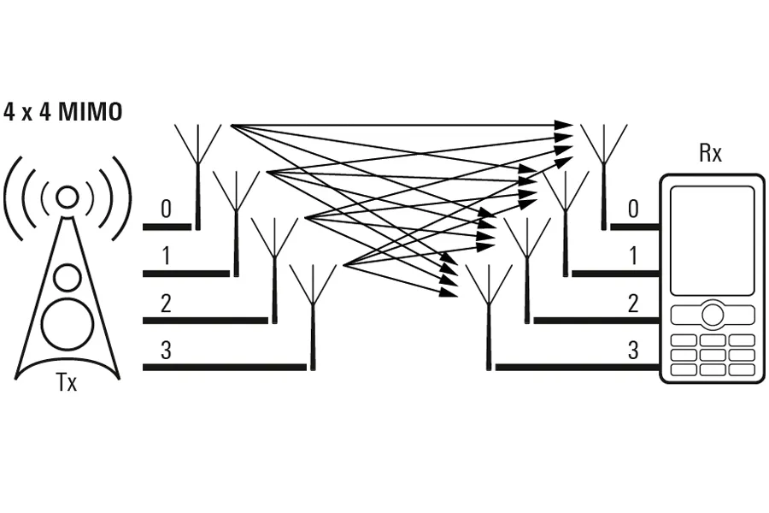
Antenna Diversity
Increase number of antennas at either receiver or transmitter end to establish multiple links between Tx and Rx

Slide 4
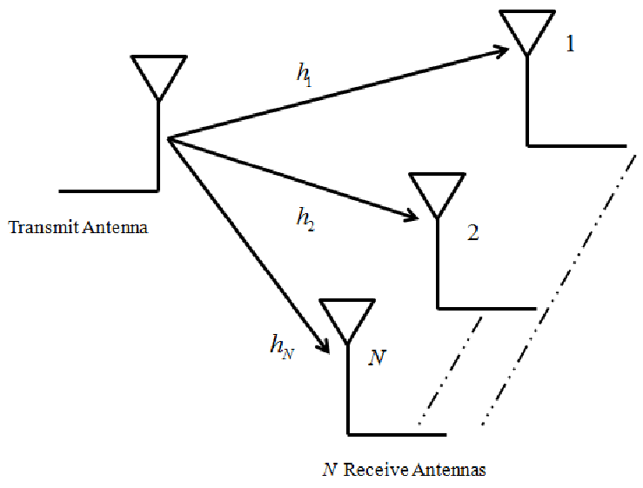
Receive Diversity

Slide 5
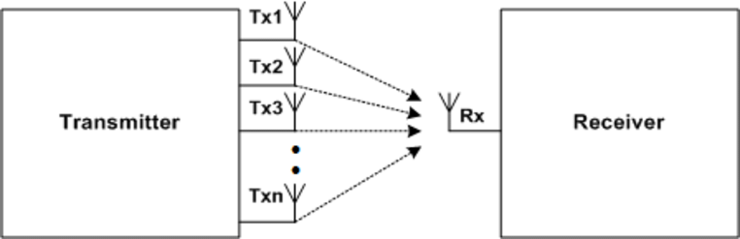
Transmit Diversity

Slide 6
Space-Time Codes
Transmit Diversity
Multiple copies of same message at different time slots
Space Time Block Codes (STBCs)
Alamouti Codes
Space Time Trellis Codes (STTCs)
Better Performance but more complex

Slide 7
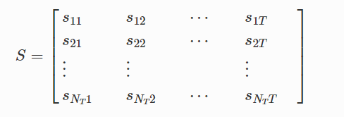
Space Time Block Codes (STBCs)
Rows represent antenna on transmitter side
Columns represent various time slots

Slide 8
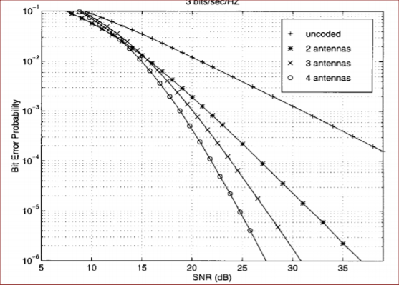
Performance of SBTCs

Slide 9
Orthogonal Design
Orthogonal matrices are n x n squares
N x M matrices can be designed to be semi-orthogonal
A(A^T) = I
Designed for simpler and linear decoding at receiver end
Sacrifices data rates

Slide 10
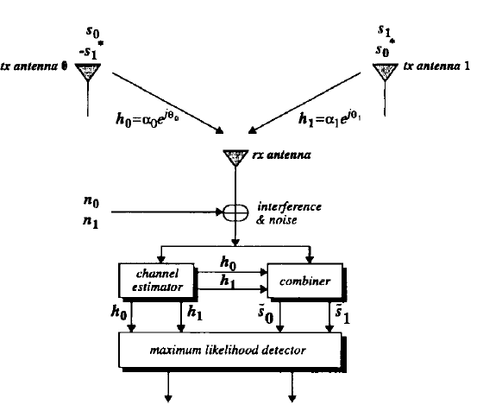

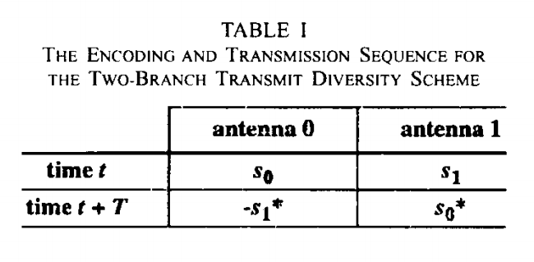
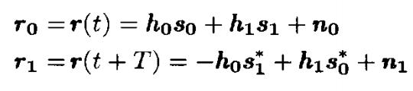
Basic Alamouti Scheme
Two transmit, one receive [1]
Assumptions:
Channel coefficients are known.
Channel coefficient is constant across two transmit instances.
Available signal power at transmitter is divided evenly across each transmit antenna.

Slide 11
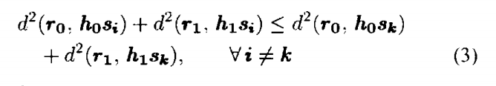
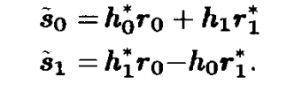
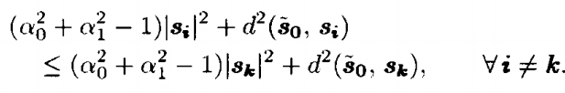

Combining Scheme
Maximum Likelihood Decision Rule:
Substituting expression for r0 and r1:

Slide 12
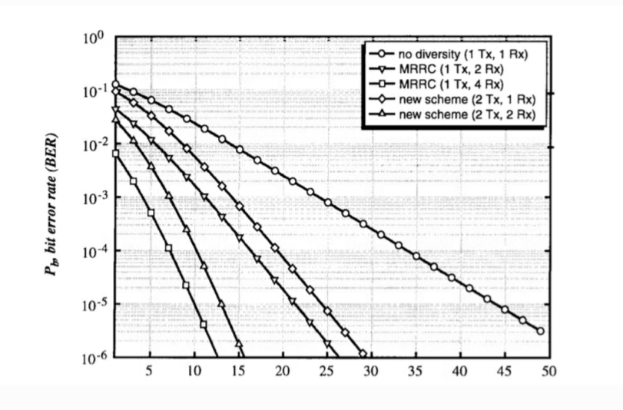
BER Simulation
[1]

Slide 13
Advantages of Alamouti code
MIMO & SISO

Slide 14
Applications
The Alamouti space-time block coding can be used to reduce the BER of a system, at a specific SNR, without any loss on the data rate.

Slide 15
Alamouti Code
In MATLAB

Slide 16
References
[1]: S. M. Alamouti, “A simple transmitter diversity scheme for wireless communications,” IEEE J. Select. Areas Commun., vol. 16, pp. 1451–1458, Oct. 1998
[2]: Rao K.D. (2019) Space-Time Coding. In: Channel Coding Techniques for Wireless Communications. Forum for Interdisciplinary Mathematics. Springer, Singapore. https://doi.org/10.1007/978-981-15-0561-4_12

